Slide 1

Comparing Ontotext KIM and Apache Stanbol
Vladimir Alexiev, PhD, PMP

Slide 2
Presentation Outline
What is Ontotext KIM?
What is Apache Stanbol?
KIM Showcases: Latest News, Exopatent
KIM-annotated Document
Stanbol-annotated Document
Comparison and Conclusions
Comparing KIM and Stanbol
Sep 2011
#<number>

Slide 3
What is Ontotext KIM?
KIM is a product of Ontotext, provider of core semantic technologies
Long-established Semantic Annotation and Search platform (over 6 years)
Based on the open-source GATE platform (General Architecture for Text Engineering) that is not just established but entrenched (16 years)
Comparing KIM and Stanbol
Sep 2011
#<number>

Slide 4
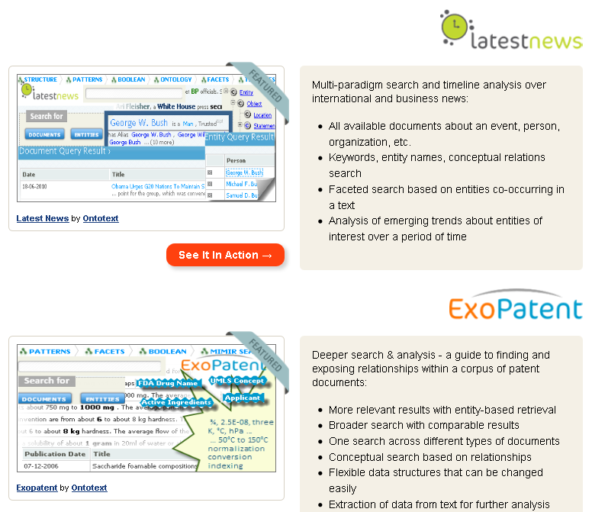
KIM Showcases
KIM Showcases include two live annotation demos:
  Latest News (general news stream), including a World KB of some 500k entities
  Exopatent (drug patents: complex domain and relations)
Comparing KIM and Stanbol
Sep 2011
#<number>

Slide 5
What is Apache Stanbol?
Currently in incubation at Apache Foundation
Part of the EU research project IKS (Interactive Knowledge Stack)
  4 years (2009-2012), 6.6 MEUR co-funding
  Open source modular software stack and reusable set of components for semantic content management
Focused on building a flexible technology platform for semantically enhanced Content Management Systems
  IKS provides 40 Early Adopter grants (5k-7k EUR) to CMS willing to integrate Stambol
  Integrates to Nuxeo and 5 other CMS
  9 more contracts are signed, 22 more proposals received
Implements 3 and plans 6 Services
Implements 3(?) and plans 7 Enhancement (annotation) Engines
Entities: small index of approx. 43k dbpedia entities comes with the default installation.
Comparing KIM and Stanbol
Sep 2011
#<number>

Slide 6
Document to Annotate (from LatestNews )
Let's give it a try!
Click on a random document in LatestNews
Document metadata is extracted by KIM and includes:
As you will see on next page, Key Phrases and Entities are extracted quite precisely
Date | 08-09-2011
Title | Capital trend that just won’t die
Source | The Independent
Language | english
URL | http://rss.feedsportal.com/c/266/f/3817/s/181af8b8/l/0L0Sindependent0O0Clife0Estyle0Chouse0Eand0Ehome0Cinteriors0Cannie0Edeakin0Ccapital0Etrend0Ethat0Ejust0Ewonrsquot0Edie0E23513230Bhtml/story01.htm
Key Phrases | designer, trend, nostalgia, tray, mania trend
Key Entities | the Queen, Queen Elizabeth, Misha Black, Lisa Whatmough, Annie Deakin, Barbara Chandler, Tate Modern, Maria Holmer Dahlgren, St.Paul, Kate Adams, Joanna Feeley, Squint Ltd, London Design, London Transport Museum, London
Comparing KIM and Stanbol
Sep 2011
#<number>

Slide 7
KIM Annotated Document
How long can the Brit mania last? Rather a long time, insist trend predictors and designers showing at this month’s interior exhibitions. With Top Drawer starting this Sunday and London Design Festival just a few weeks away, the capital city is awash with iconic – and subtle - London imagery. The longevity of this Brit mania trend, it seems, lies in the originality of the designers. Instead of plastering the Union Jack or tube map prints onto everything, designers realize an urgency for creativity. Expect to find innovative twists on the London trend; a sofa upholstered in that furry seating fabric in the Tube, trays decorated with raining cats and dogs and bulldog embossed wallpaper.
Last year, a micro trend for all things London was obvious at Top Drawer, a trade show for design-led gifts and this year, sees little difference. ‘With the arrival of the Olympics and the Golden Jubilee in 2012, we’re celebrating all things London at Top Drawer this autumn,’ say the organizers of Top Drawer. Back in 2009, market forecasters Trend Bible announced that the London and transport trend would be a long-term keeper. They initially flagged up the trend of transport and nostalgia for British icons in their Voyager trend showcased in their Spring/ Summer 2011 Home Trends book written back in 2009.
‘Many of our clients have had real commercial success with a type of British nostalgia-whether it is Union Jack cushions or vintage Queen Elizabeth photographic style prints,’ says Trend Bible founder Joanna Feeley. ‘But really the question they are all asking is how they can keep this look fresh and move it forward, since British nostalgia as a trend concept continuing to be important through 2011 and into 2012 with the Queen’s Diamond Jubilee and London Olympics still to come next summer.’
The secret lies in originality and an aversion to splattering the Union Jack or tube map onto furnishings. In response to the tacky souvenirs and cheap throwaway London designs for tourists, Swedish designer Maria Holmer Dahlgren wanted to celebrate the city using contemporary graphics. The result is her London collection, which will be on show at Top Drawer this weekend. It comprises trays, mugs and aprons adorned with the Tate Modern, Brick Lane and Tower Bridge. Humour is key to her success; Dahlgren epitomizes well-known British idiosyncrasies as she pictorially sums up our wet weather with cats and dogs falling under an umbrella. Also showing at Top Drawer is ceramicist Kate Adams, of mydeco design boutique, who spent five years at Cockpit Arts where she established her London skyline tableware range. Each piece is thrown on the potter’s wheel, then individually illustrated with rugged versions of iconic buildings such as St.Paul’s Cathedral and the Gherkin.
Comparing KIM and Stanbol
Sep 2011
#<number>

Slide 8
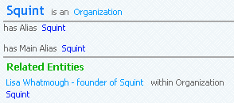
KIM Annotations
KIM annotates: organizations, persons, positions, locations, general terms, time, years, numbers
  Hover over an annotation to see its type
  Click to see entity description from World KB
  Click [+] to see more details
  Click [D] to see related documents
Even finds relations:
Lisa Whatmough, founder of Squint Ltd
Trend Bible founder Joanna Feeley
Recall and precision are both quite good! But not perfect, e.g. :
  the Queen’s Diamond Jubilee[Place]: should be [Time] like Golden Jubilee
  Dahlgren[Company]: should be [Person] as in Maria Holmer Dahlgren but that's in the previous sentence
  Tent London[Country Capital]: is actually an event (design trade show)
  London Design[Organization] Festival: is actually an event (festival)
Comparing KIM and Stanbol
Sep 2011
#<number>

Slide 9
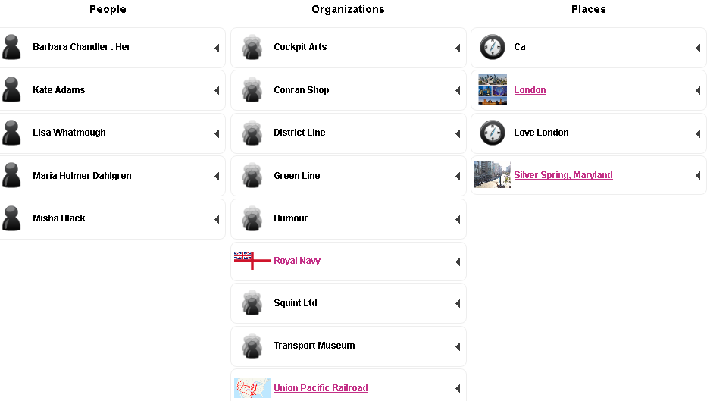
Stanbol Annotation
Go to Stanbol Demo, paste document text from LatestNews, click [Run Engines]
Comparing KIM and Stanbol
Sep 2011
#<number>

Slide 10
Stanbol Annotations
Stanbol uses the following Enhancement Engines: NamedEntityExtraction, NamedEntityTagging, CachingDereferencer
You can also select the Output format (e.g. JSON-LD, Turtle..) to see technical details and the way text is parsed
Doesn't show the annotations in context
Recognizes only Entities, not relations, dates, numbers, general concepts
Shows a map of recognized locations at the bottom
Recall is much lower than KIM, which is no wonder since Stanbol is seeded with a small KB from dbpedia
But precision is just horrendous! (see further)
Comparing KIM and Stanbol
Sep 2011
#<number>

Slide 11
Stanbol Precision
Stanbol Precision is horrendous. Text analysis problems:
  Text mangling: "St.Paul’s Cathedral" is parsed as "St.Paul s Ca l" (why chars are replaced with spaces ??) which leads to identifying "Ca" as a place. But the article does not mention California even once!
  Sentence segmentation: "Barbara Chandler . Her": why "Her" from next sentence is tacked to this entity?
  Incomplete matching: took only the bold words from "Love London" (a book), "London Transport Museum" (an organization)
  Missed co-reference: "Whatmough" not recognized the same as "Lisa Whatmough"
NamedEntityTaggingEngine makes up facts trigger-happily:
  Silver Spring, Maryland from "Spring/ Summer 2011"
  Union Pacific Railroad, Auto Union and International Astronomical Union (!?) from "Union Jack " (the English flag)
  Royal Marines, Royal Navy, Royal Air Force from "the Royal wedding"
Wrong entity identification:
  "District Line" and "Green Line" are not Organizations but subway lines
  "Humour" is not an Organization but a word
Comparing KIM and Stanbol
Sep 2011
#<number>

Slide 12
Comparison of Annotations
KIM:
  Person: Queen Elizabeth=the Queen, Joanna Feeley, Maria Holmer Dahlgren, Annie Deakin, Barbara Chandler, Misha Black, Lisa Whatmough=Whatmough, Kate Adams
  Wrong: Tate Modern
  Organization: Trend Bible, Squint Ltd, London Transport Museum
  Wrong: London Design Festival, Dahlgren
  Place/Facility: London, Regent Street
  Wrong: Diamond Jubilee
  Position: founder
  General concept: designers, trend, nostalgia, tray(s), mania trend
  Time reference: this month, this Sunday, Last year, this year, Golden Jubilee, Spring, Summer, this autumn, next summer, 17-25 September, this weekend, five years, 100 years
  Year: 2008, 2009, 2011, 2012
Stanbol:
  Person: Kate Adams, Lisa Whatmough, Maria Holmer Dahlgren, Misha Black
  Wrong: Barbara Chandler . Her
  Organization: Cockpit Arts, Conran Shop, Transport Museum, Squint Ltd
  Wrong: District Line, Green Line, Humour, Royal Navy, Union Pacific Railroad
  Wrong (lower confidence): Auto Union, International Astronomical Union, Royal Marines, Royal Air
  Place: London
  Wrong: Love London, Ca, Silver Spring Maryland
Comparing KIM and Stanbol
Sep 2011
#<number>

Slide 13
Comparison of Recall and Precision
We compare only Person + Organization + Place
  KIM also annotates Position, General concept, Time reference, Year, Number
KIM
  Recall: 15/19=79%
    found 10+3+2=15 correct (including2 co-references)
    missed 4 orgs (the org missed in "market forecasters Trend Bible" but found in "Trend Bible founder Joanna Feeley")
  Precision: 15/19=79%
    found total 11+5+3=19, wrong 1+2+1=4
Stanbol
  Recall: 9/19=47%
    found 4+4+1=9 correct
  Precision: 9/18=50%
    found total 5+9+4=18, wrong 1+5+3=9
    If lower confidence mis-hits are taken into account: 9/22=41%
Comparing KIM and Stanbol
Sep 2011
#<number>

Slide 14
Conclusions
Stanbol is a promising open source project that may bring semantic technologies to mass-market CMS systems
  Another similar project is SCMS (Semantic Content Management Systems for Enterprise Knowledge Management & News Mining) funded under the Eureka EuroStars program
Stanbol creates useful research and training materials:
  E.g. paper A Semantic Backend for Content Management Systems
  E.g. training presentation Semantifying Your CMS
Stanbol may establish a "reference architecture" for integrating CMS to semantic technology components (e.g. CMS Adapter component, FactStore API, CMIS API…)
However, semantic content processing in Stanbol is still far behind established text analysis frameworks
Comparing KIM and Stanbol
Sep 2011
#<number>

